Slide 1

Final Engagement
Attack, Defense & Analysis of a Vulnerable Network

Slide 2
RED TEAM
2

Slide 3
Table of Contents
This document contains the following resources:
Network Topology & Critical Vulnerabilities
Exploits Used
Avoiding Detection
Maintaining Access

Slide 4
Network Topology
& Critical Vulnerabilities
4

Slide 5
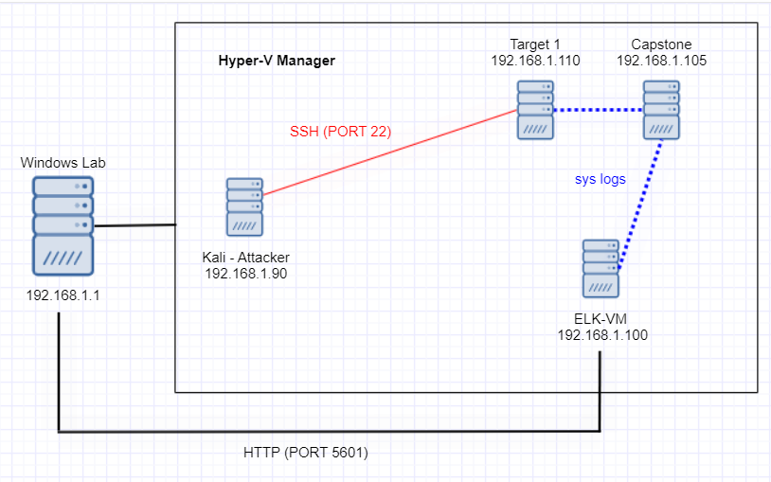
Network Topology
Network
Address Range: 192.168.1.1-255
Netmask: 255.255.255.0
Gateway: 10.0.0.1
Machines
IPv4: 192.168.1.105
OS: Linux
Hostname: Capstone
IPv4: 192.168.1.100
OS: Linux
Hostname: ELK
IPv4: 192.168.1.90
OS: Kali Linux
Hostname: Kali
IPv4: 192.168.1.110
OS: Linux
Hostname: Target

Slide 6
Critical Vulnerabilities: Target 1
Our assessment uncovered the following critical vulnerabilities in Target 1.
Vulnerability | Description | Impact
OpenSSH | Transport layer protocol that could allow a remote attacker to execute commands. | SSH keys can be used by an attacker to gain access to networks to move freely.
rpcbind | Server that converts Remote Procedure Call (RPC) program numbers into universal addresses. Also known as portmapper. | Can be used to cause excessive use of system resources.
netbios-ssn | Protocol to connect two computers to transmit heavy data traffic, mostly used for printer and file services over a network | May cause DoS (Denial of Service) attack or buffer overflows.

Slide 7
Exploits Used
7

Slide 8
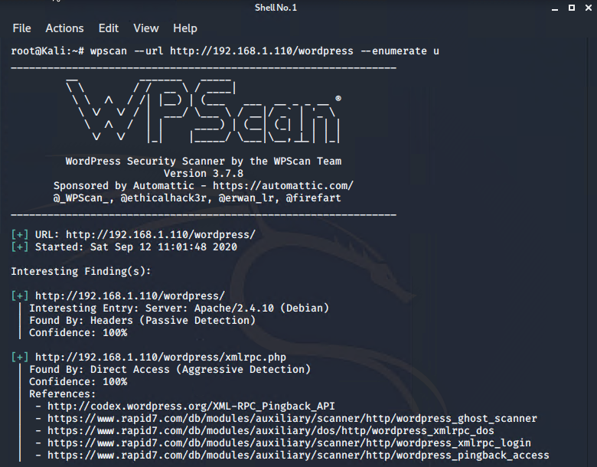
Exploitation: WPScan
WPScan was used to enumerate users on the WordPress site.
Access to the vulnerable web server was gained using SSH with Michael’s credentials after “guessing” his password.
This exploit achieved access to Michael’s root file, but not root access privileges, to find Flags 1 and 2.

Slide 9
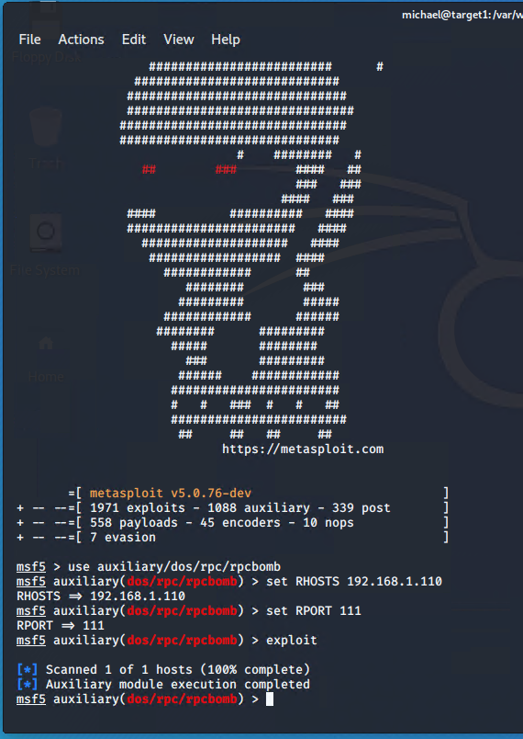
Exploitation: rpcbomb (rpcbind exploit)
Confirmed that rpcbind was running on the vulnerable web server by running the command: rpcinfo –p 192.168.1.110 from the Kali VM.
Using Metasploit to exploit this vulnerability can cause excessive memory allocations that could exhaust the systems memory causing a DoS attack.

Slide 10
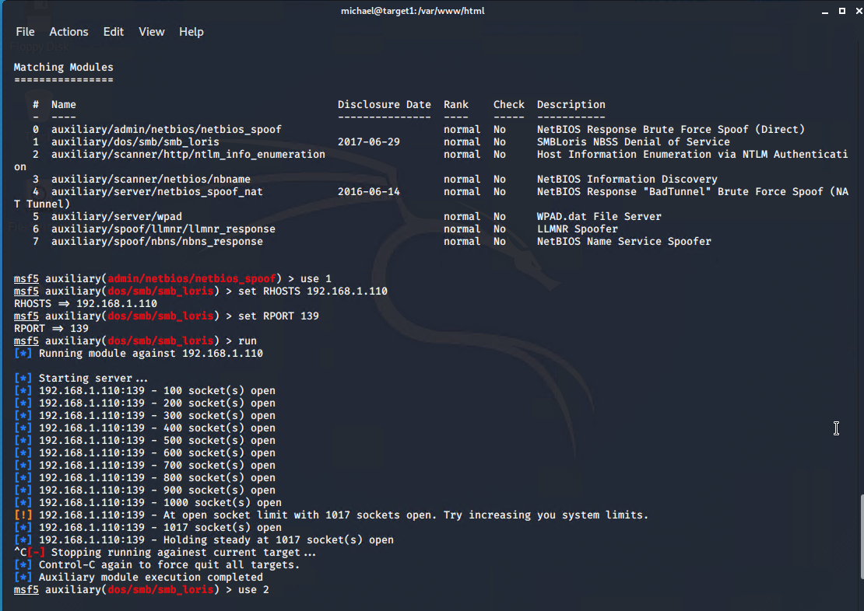
Exploitation: netbios-ssn
Within Metasploit, there are several exploits that can be used.
As an example: using smb_loris can cause an application-level DoS attack.

Slide 11
Avoiding Detection
11

Slide 12
Exploitation: WPScan
Monitoring Overview
Excessive HTTP Errors alert would detect this exploit.
Metric: HTTP status code
Threshold: above 400
Mitigating Detection
Creating an undetectable custom SSH Backdoor in Python will execute without triggering an alert.
An alternative exploit is SSH Tunneling, where a hacker can leave a backdoor into the internal network. It can also be used to cover his tracks.
Sources: https://resources.infosecinstitute.com/creating-undetectable-custom-ssh-backdoor-python-z/#gref
https://resources.infosecinstitute.com/creating-undetectable-custom-ssh-backdoor-python-z/#gref

Slide 13
Exploitation: rpcbomb
Monitoring Overview
CPU Usage Monitor alert would detect this exploit.
Metric: Percentage of CPU time spent by the process since the last update.
Threshold: above 0.5 (50%)
Mitigating Detection
Bypass filtered portmapper port by simulating a local portmapper service and tunnel the Network File System (NFS) port from the attacker machine to the victim one. This will allow the use of regular tools to exploit this service.
Source: https://book.hacktricks.xyz/pentesting/pentesting-rpcbind

Slide 14
Exploitation: NetBIOS with open port 80
Monitoring Overview
HTTP Request Size Monitor alert would detect this exploit.
Metric: HTTP range request
Threshold: all documents above 3500 for the last 1 minute
Mitigating Detection
A similar attack is leveraging NetBIOS over TCP/IP (NBT) to spoof Web Proxy Auto-Discovery Protocol (WPAD). WPAD is used by web browsers to configure proxy settings in which to access web-based resources. An attacker can spoof the WPAD IP address, serve up an altered wpad.dat file, and then view all browser traffic of a victim’s computer.
Source: https://10dsecurity.com/saying-goodbye-netbios/

Slide 15
Maintaining Access
15

Slide 16
Backdooring the Target
Backdoor Overview
Type of Backdoor: Meterpreter Reverse TCP Shell over port 62000 or higher to avoid suspicion
Use msfvenom to create a payload and save it as a python script (reverse_tcp.py) -> Gained root access with Steven’s account by escalating privileges with another python script -> upload the file to the server.
Actively open a netcat listener with a bash script.
$x=true; while $x = True: nc –l –p 62000 < reverse_tcp.py
Attacker Machine: nc 192.168.1.110 62000 > reverse_tcp.py
Source: David Han, Trilogy Education Services Tutor

